Slide 1
PRESENTATION ON SACRED PLANTS &
ROLE OF ETHNIC GROUPS IN CONSERVATION OF PLANT GENETIC RESOURCES

Slide 2
SACRED PLANTS

Slide 3
SACRED PLANTS USED BY TRIBAL PEOPLE
Sacred plants are plants or plant parts used in various cultural and religious rites and rituals the tribals for their spiritual promotions.
In India, this deep knowledge of and faith in plants, animals and forests has largely contributed to natural conservation of the environment and its biodiversity.
There is also a belief that the plants, which are sacred to the Gods and Goddess, they have the medicinal utilities and the power of relieving a person from the diseases.

Slide 4

a) BHANG
BOTANICAL NAME : Cannabis sativa
COMMON NAME ENGLISH NAME FAMILY
: Bhang
: Cannabis, Hemp
: Cannabinaceae
PART USED : Leaves
CHEMICAL CONSTITUENTS : Cannabinoids, including delta – 9- tetrahydrocannabinol (THC) and cannabidiol (CBD).

Slide 5
BOTANICAL CHARACTERISTICS :
Cannabis sativa is an annual herbaceous flowering plant.
HEIGHT : can grow to 1-5m tall.
ROOT SYSTEM : extensive root system, & is able to tolerate dry conditions.
FLOWERS : Flowers of the female plant are arranged in
racemes & can produce hundreds of seeds.
LEAVES : palmate, stipulate, present alternatively, & have long petiole.

Slide 6
ETHNOBOTANICAL USES :
It has been used for the treatment of various diseases innumerable ethnic Apcieties in Asia.
It is well known for various froms of non-formal medicinal breatments
It is one of the oldest food, fibre, medicinal, psychoactive and oil plants known.
People use cannabis to treat cited ailments like sleep associated problems, CNS problems & infections & respiratory problems followed by rheumatism, gastrointestinal, gynecological, cancer and other ailments including hypertension, headache, itch, increases bils secreation, fever –and urinary problems.

Slide 7
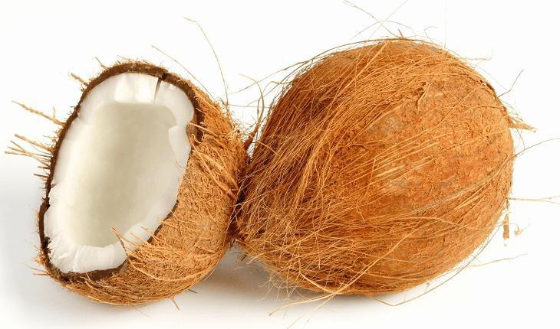
b) NARIYAL
BOTANICAL NAME : Cocos nucifera
ENGLISH NAME FAMILY
PART USED
: Coconut
: Arecaceae
: Fruit
BOTANICAL CHARACTERISTICS :
It is a large palm, growing up to 30 m (100 ft) tall. Pinnate leaves are present.
It is a long-lived plant can live as long as 100 years.
It’s bark is smooth and gray.

Slide 8
ETHNOBOTANICAL USES :
COCONUT WATER : In case of chicken pox and smell fox, tender coconut water is specially recommended to coolthe body.
  It moderates the heart beat & strengthens heart muscles.
COCONUT OIL : In cough, cold and diseases of ear and secretions from mucus membrane, medicated coconut oil is effective.
COCONUT KERNEL : It is cooling and effective against dysentery, hemophilia and diabetes, and effectively used in postnatal treatment.
COCONUT MILK : Refreshing drink & is mainly used as an antidote.For the promotion of health of children from the very stage of newborn baby, coconut milk & various preparations of coconut oil are widly used.

Slide 9
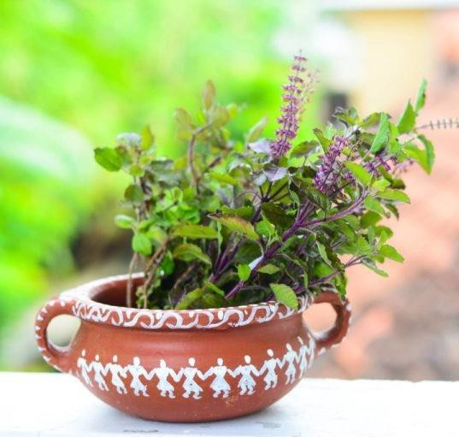
c) TULSI
BOTANICAL NAME : Ocimum tenuiflorum
(Syn. : Ocimum sanctum)
ENGLISH NAME : Holy basil
FAMILY : Lamiaceae (Labiatae)
PART USED : Leaves
CHEMICAL CONSTITUENTS : Essential oil from leaves contains methyl cinnamate, terpinene, ocimene, safrole, eugenol, borneol etc.

Slide 10
BOTANICAL CHARACTERISTICS:
An arometic, erect annual herb.
Can grow up to 35cm in height.
Purple or white colored flowers are arranged as a spike.
Srong scented, gland diffed leaves.
Seeds of basil are black in color

Slide 11
ETHNOBOTANICAL USES OF TULSI :
Oil is reported to possess antibacterial properties & acts as an insecticide.
Juice of leave gives relief in common cold, fever, bronchities, cough, digestive problems etc.
Tulsi oil is also used as ear drops in case of pain.
Tulsi is a natural mouth freshner & an oral disinfectant.

Slide 12
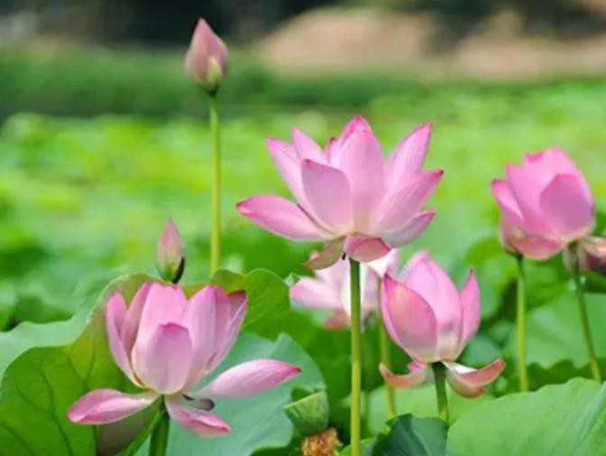
d) KAMAL :
BOTANICAL NAME : Nelumbo nucifera
ENGLISH NAME FAMILY
PART USED
: Lotus, Indian lotus
: Nelumbonaceae
: Flower
BOTANICAL CHARACTERS :
The aquatic sacred Lotus plant is grown worldwide.
8-inch-wide, showy flowers.
Round, upward-cupped waxy green leaves that can reach 2 ft. across.
Stem of lotus is called Rhizome.
Sacred lotus grows in areas of shellow water.

Slide 13
ETHNOBOTANICAL USES :
Sacred lotus has been used as a food source and ingredient for traditional herbal remedies.
Lotus Rhizome being rich in starch, vitamins, minerals, is widely consumed by people.
Seed powder is used against cough.
Lotus Flowers, floral parts or their extracts have also been used against many diseases like hypertension, cancer, weakness, male sexual disorders, syphilis, etc.

Slide 14
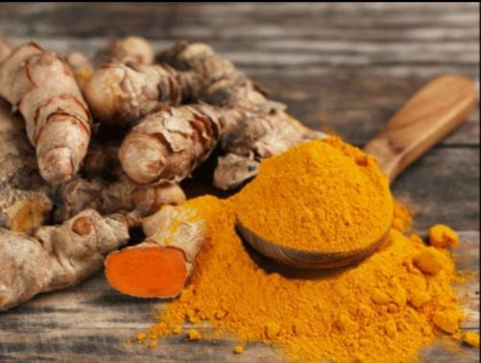
e) HALDI
BOTANICAL NAME : Curcuma longa
ENGLISH NANE FAMILY
: Turmeric
: Zingiberaceal
PART USED : Rhizome
CHEMICAL CONSTITUENTS :
Phizome contain curcumincids which are responsible for the yellow colour. Curcumins comprises: curcumin I (curcumin), curcumin II (dimethoxycurcumin) and curcumin III (bisdemethoxy curcumine).

Slide 15
BOTANICAL CHARACTERISTICS :
An upright, perennial herb to about 1m tall.
The rhizome (underground stem) is thick & highly branched.
It only reproduces via its rhizomes.
Leaves are oblong, up to 1 m long, dark green on upper surface, pale green beneath.

Slide 16
ETHNOBOTANICAL USES :
Turmeric is considered sacred by Hindus.
It is offered to deities during religious ceremonies.
Turmeric is used as one of the nine plants of navapatrika during Durga festival.
Turmeric powder is added to pickles as flavouring and colouring agent
Indian have been using turmeric as a spice for thousands of years.
Extensively used in Ayurvedic, Unani, Chinese and traditional medicinal prepations.

Slide 17
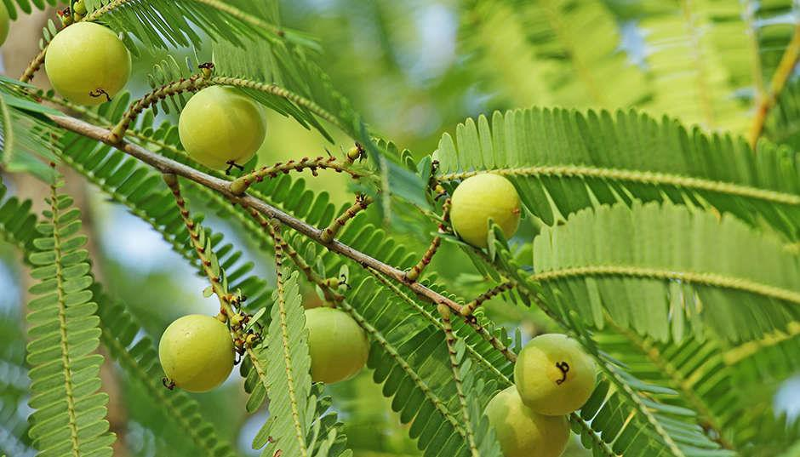
f) AMLA
BOTANICAL NAME : Emblica officinalis
ENGLISH NAME FAMILY
: Indian gooseberry
: Euphorbiaceae
PART USED : Whole plant
CHEMICAL CONSTITUENTS –
Active constituents are due to tannins, Vit.C, four other auxinsal, a3, a4, a5, 2 growth inhibitors R1& R₂

Slide 18
BOTANICAL CHARACTERISTICS :
Deciduous tree, medium in height grows up to 8m with slightly curved trunk.
Leaves are finely & closely set along the branchlets. Leaves have pinnate resemblance, very tiny.
It contains spherical fruit yellowish green in color with 6 vertical stripes.
ETHNOBOTANICAL USES :
Amla is traditionally used for several discases, and it is believed to increase the defence against diseases,
It nutrilizes snake venom.
It is one of the main constituents of Triphala which is used for the management of common cold, pharyngitis, & constipation.

Slide 19
g) SADABAHAR
BOTANICAL NAME : Catharanthus roseus
ENGLISH NAME FAMILY
PART USED
: Rose Periwinkle
: Apocynaceae
: Leaf, root & whole plant
CHEMICAL CONSTITUENTS :
Ajmalicine, reserpine, catharanthine, etc are present in roots and basal stem.
Flowers are rich in catharenthine, ajmalicine, and reserpine & vindoline, etc.

Slide 20
BOTANICAL CHARACTERISTICS :
Evergreen 1m tall herb.
Leaves are oval to oblong.
Flowers are white to dark pink with a dark red centes
Leaves axe glossy green hairless with a short petiole.
ETHNOBOTANICAL USES :
Juice of leaves is used for bee and wasp sting .
Decoction of leaves is used in diabetes, stomach cramps etc.
Crude leaf and root extracts anti- cancers activity.

Slide 21



ROLE OF ETHNIC GROUPS IN CONSERVATION OF
PLANT GENETIC RESOURCES

Slide 22
The life of ethnic or indigenous societies is intimately associated with the forest wealth.
There has been a misconception that ethnic communities and tribals destroy the biodiversity.
The new insights based on ethnobotanical researches, have shown that these communities are involved in sustainable use of biological resources.
The ethnic communities and tribals also follow some practices which help in biodiversity conservation.
These practices are mainly related with their beliefs and taboos about some plants and animals, and it help in protection and conservation of those species.

Slide 23
THESE CONSERVATION MEASURES ARE DISCUSSED
BELOW:
1. Beliefs and Taboos :
▫️Some plant species are believed to be originated from the body of gods and deities and have special mythological significance.
▫️These associations have direct relation with the biodivesity and help in conserving the associated species in the ecosystem.
» Lotus is believed to be originated from the navel of Lord Vishnu.
» Cutch Tree or khair (Acacia catechu) is considered as the torso of Brahma.
» Jains believe in non- injury to any life form.
» The flora of Paranath hills im Jharkhand has been saved due to this faith.
» Use of citrus fruits is prohibited before Sair fair in Himachal Pradesh.

Slide 24
2. Wild Plants in Tribal Courtyards :
Some useful wild animals and small shrubs are grown by tribals in their courtyards apart from cereals, pulses and millets.
The courtyard plants in some different regions of India are discussed below :
Western Himalayas : Zanthoxylum armatum, Rubus, Prunus sorbus, Malus and Rosa spp.
Northern-East India : Citrus spp., Smilax macrophylla, Docynia indica, Mangifera sylvatica andmany more.
khasi Hills : Piper peepuloides.

